Slide 1
Logistic Regression
Binary Outcomes & Classification
(Y = 0 or 1)

Slide 2
Binary Variables
Binary variables are indicator variables used to code categories or conditions.
Sales = B0 + B1(Advertising) + B2(Rain) + E
Interpretation of B2: The change in sales associated with rainy days versus non-rainy days
Date | Sales | Advertising | Rain
7/1 | 30 | $100 | 0
7/2 | 35 | $125 | 1
7/3 | 33 | $120 | 1

Slide 3
Binary Variables
We can also have binary dependent variables.
Used for classification problems
Pass or fail? Win or lose? Accept or reject?
Pass Exam | Study Time | Days Absent | Stats Major
1 | 10 | 2 | 0
1 | 11 | 1 | 1
0 | 3 | 4 | 0

Slide 4
The Linear Probability Model
P(Pass = 1) = B0 + B1(Study Time) + B2(Days Absent) + B3(Stats Major)
If estimated by OLS, this is called a linear probability model
Interpretation of B2: The change in the probability of passing the exam associated with an additional day absent
Pass Exam | Study Time | Days Absent | Stats Major
1 | 10 | 2 | 0
1 | 11 | 1 | 1
0 | 3 | 4 | 0

Slide 5
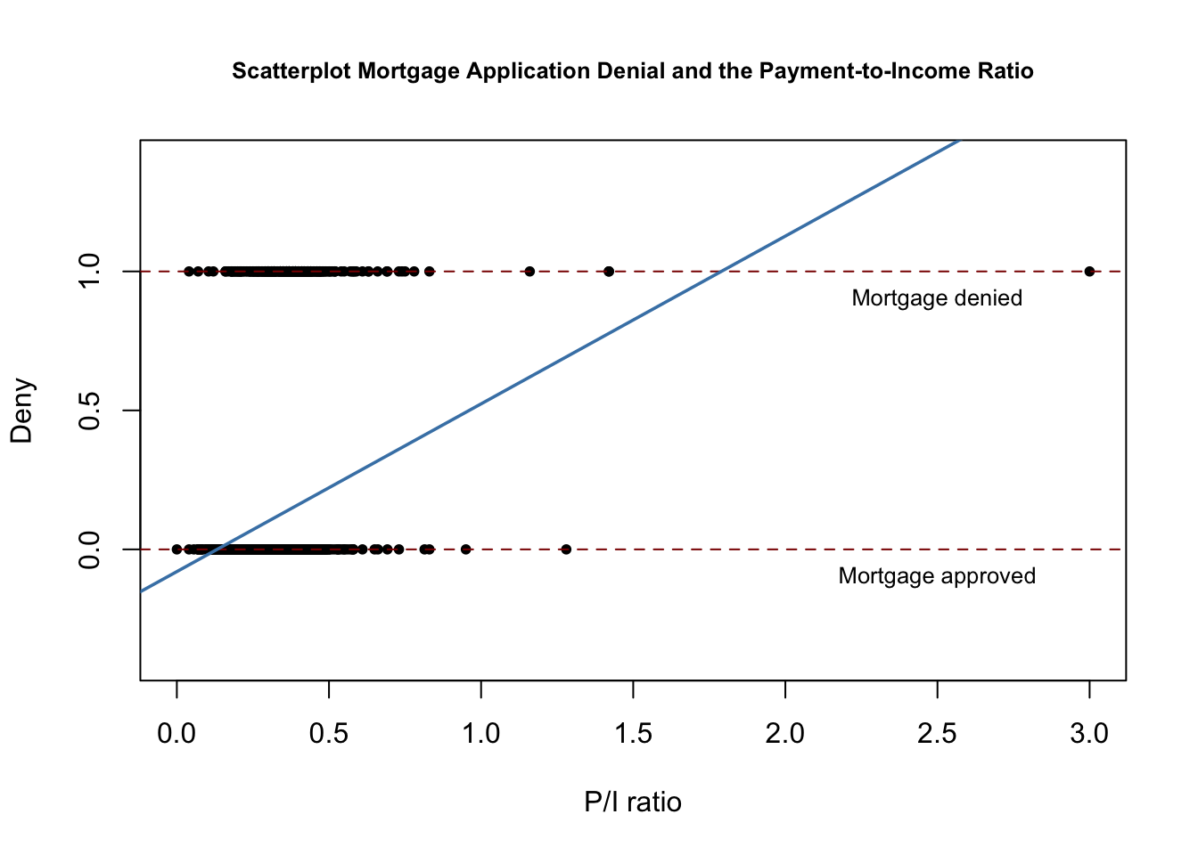
Problems with the Linear Probability Model
Easy to use
But has lots of problems
Errors aren’t normally distributed since Y only takes two values.
Errors are heteroskedastic
Predicted probabilities can be above 1 or below 0
Assumes a constant linear effect on probability (often unrealistic)
Use logistic regression instead!

Slide 6
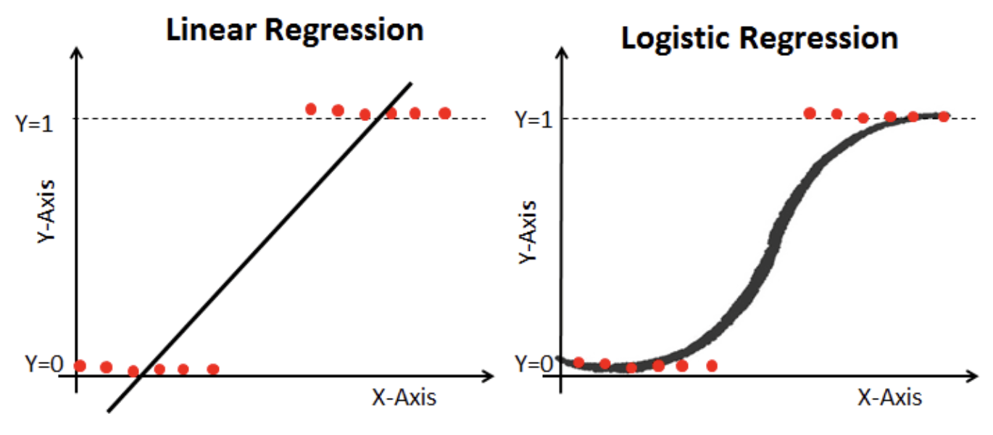

Slide 7
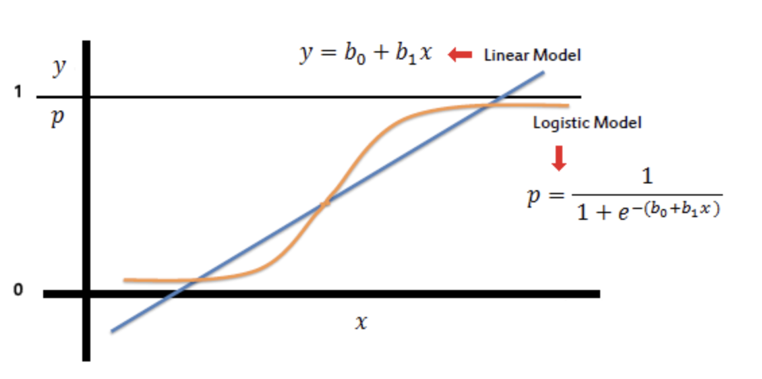

Slide 8
Likelihood and Maximum Likelihood Estimation
Likelihood: A measure of how plausible the observed data are for different parameter values
Maximum Likelihood Estimation: A method for choosing parameter values that make the observed data most plausible under the model
Logistic regression is estimated using MLE, not OLS
More on MLE

Slide 9
Logistic Regression Assumptions
Binary dependent variable
Independent observations
Correct functional form
No severe multicollinearity
Sufficiently large sample size
No highly influential outliers
No complete or quasi-complete separation (one variable can be used to perfectly / near-perfectly classify Y)

Slide 10
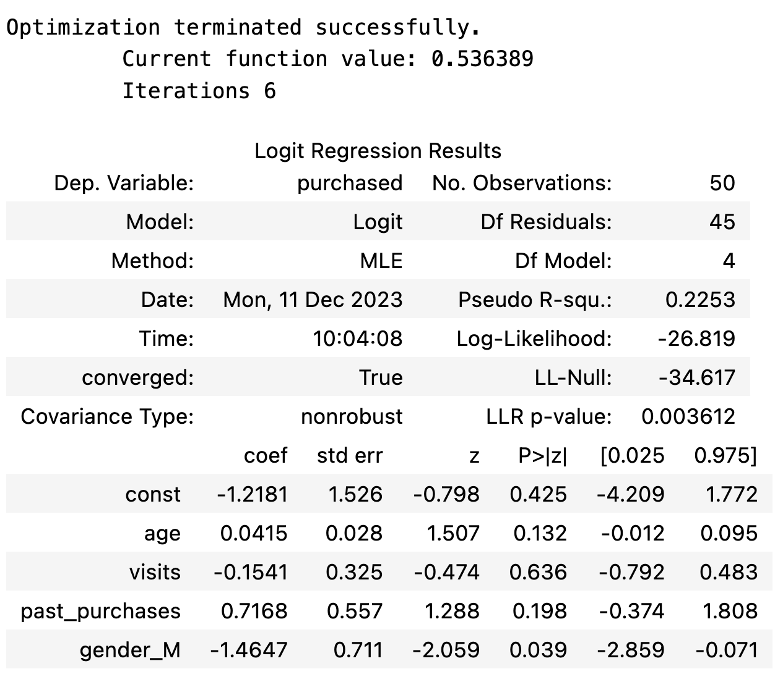
Interpreting Logit Results
Pseudo R^2: Not the same as R^2, but higher is generally better
Log-Likelihood: No direct interpretation, but useful as input in calculation for comparing models
Log-Likelihood Null: The log-likelihood for a model with no explanatory variables
LLR p-value: Similar to p-value for an F-Test for full model, testing H0: All slope coefficients equal 0
If LLR p-value >= alpha

Slide 11
Pseudo R^2
There is no R^2 for logistic regression, but there is “Pseudo R^2”
They are similar in concept, but not the same and interpretation is not the same at all.
There are several formulations: Statsmodels uses McFadden’s Pseudo R^2 by default.
= 1 - [ln(Lm) / ln(L0)] where Lm is the likelihood for the fitted model and Lo is the likelihood for a model without any predictors.
Pseudo R^2…
Can be used to compare models.
Is often low, relative to R^2 from OLS
Is bounded between 0 and 1, with higher values indicating a better fit
Cannot be used to compare models of different types or different dependent variables

Slide 12
Interpreting Logit Results
Odds = p / (1 - p)
log(p / (1 - p)) = log(odds) = B0 + B1X1
Interpretation of Coefficients:
A one-unit increase in X1 is associated with a B1 increase in log odds of Y = 1
A one-unit increase in X1 is associated with an [((e^B1) - 1) * 100%] increase in the odds of Y = 1
One additional year of life is associated with a 0.0415 point increase in the log odds of purchasing and a 4.15% increase in the odds of purchasing
Confusing and not very helpful, right?!

Slide 13
Interaction Terms
Y = 1 if student passes, X1 = study time, X2 = tutoring attendance
log(p/(1-p) = B0 + B1(study) + B2(tutor) + B3(study*tutor) + E
B1 = Effect of studying when tutor = 0
B2 = Effect of tutor when studying = 0
B3 = How the effect of studying changes when tutoring changes
Best to interpret with marginal effects and predicted probabilities

Slide 14
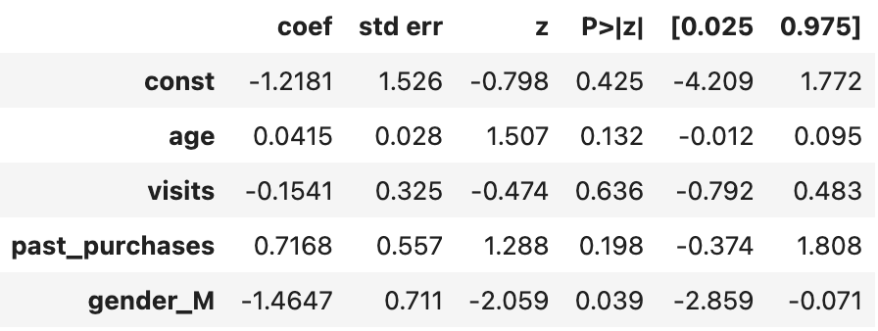
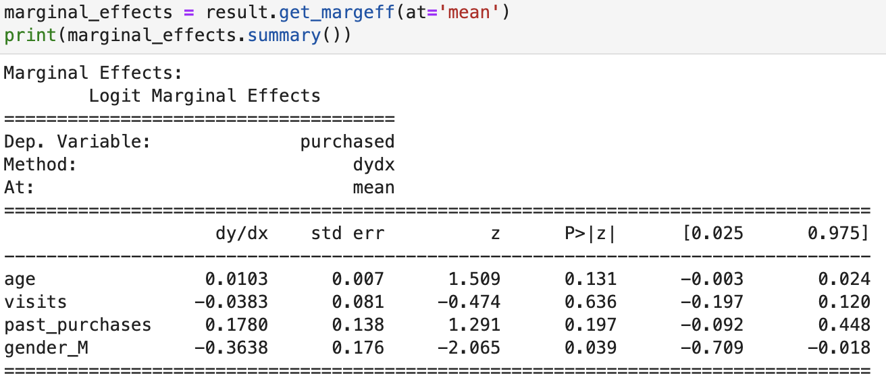
Interpreting Logit Results - Marginal Effects
Marginal Effects: The change in predicted probability associated with a one-unit increase in X, holding other variables fixed (at their mean value, typically).
An additional hour of study time might matter more for a “marginal” student than someone already doing well, so choice of where the effect is evaluated matters.
For each additional year of life, the probability of purchasing increases by 1.03 percentage points
For each additional past purchase, the probability of purchasing increases by 17.8 percentage points
Marginal effects are much more useful and can be calculated by Python, R, and most other stats software.

Slide 15
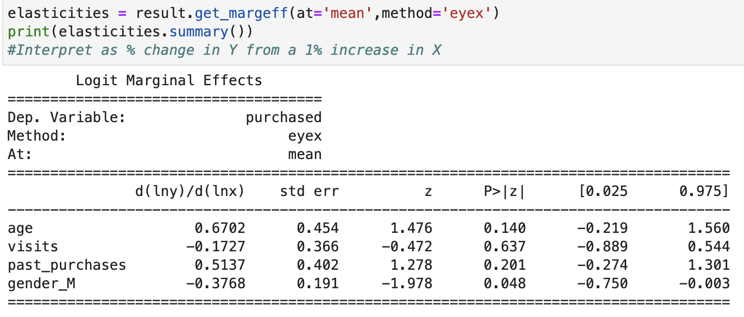
Interpreting Logit Results - Elasticity
Elasticity: The percent change in predicted probability associated with a 1% change in X
A 1% increase in age corresponds to a 0.67% increase in the probability of purchasing
1 1% increase in past purchases is associated with a 0.51% increase in the predicted probability of purchasing

Slide 16
Marginal Effects and Elasticity with Statsmodels
For fitted discrete models like Logit, statsmodels uses get_margeff(). The main at= options are:
'overall' for average marginal effects
'mean' for marginal effects at the mean
'median' for marginal effects at the median
'zero' for marginal effects at zero
'all' for marginal effects at each observation
And the method= options include:
'dydx' for ordinary marginal effects
'eyex' for elasticity
'dyex' for semi-elasticity dy/dln⁡xdy / d\ln xdy/dlnx
'eydx' for semi-elasticity dln⁡y/dxd\ln y / dxdlny/dx

Slide 17
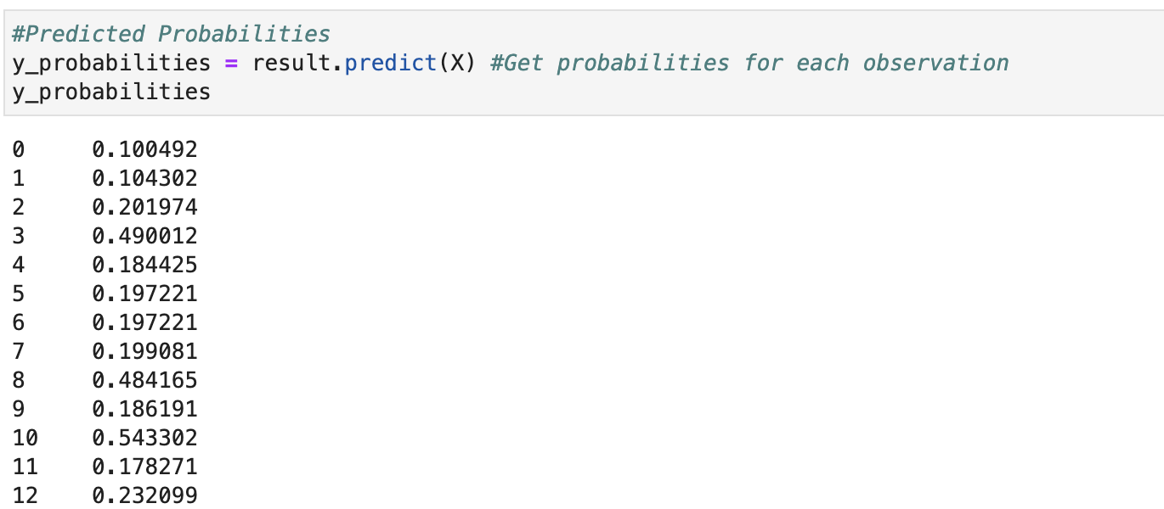
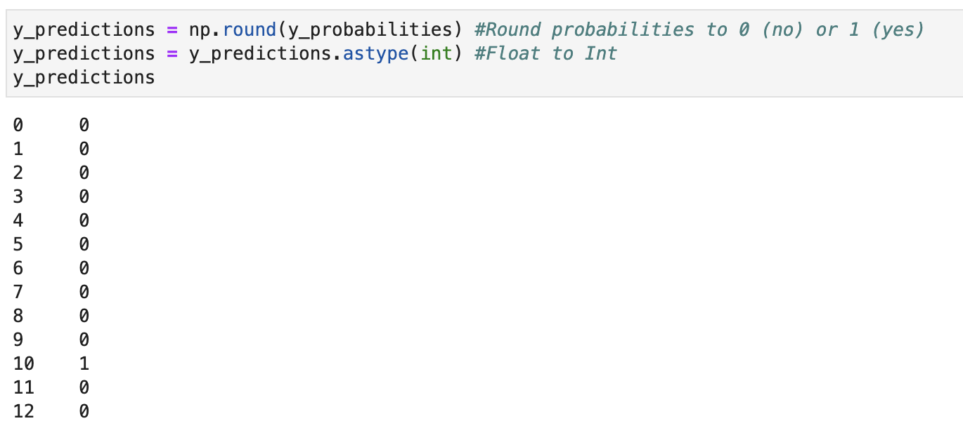
Probabilities and Prediction
Y-Hat is the probability of Y being 1
Prediction is done by recoding Y-Hat as either 0 or 1 based on a cutoff, typically 50%

Slide 18
Confusion Matrix
Four Possible Outcomes
True positive: Case is positive and predicted positive
True negative: Case is negative and predicted negative
False negative: Case is positive but predicted negative
False positive: Case was negative but predicted positive
Confusion Matrix:
 | Predicted Positive | Predicted Negative
Actual Positive | TP | FN
Actual Negative | FP | TN

Slide 19
Classification Report
Accuracy = (TP + TN) / (TP + FP + FN + TN)
Accuracy tells the percentage of predictions made correctly
Accuracy can be misleading with imbalanced classes
Precision = TP / (TP + FP), favors low false positives
Precision tells us what percentage of predicted positives were actually positive
Precision of 0.73 means that out of all customers that the model predicted would purchase, 73% of them did
Recall = TP / (TP + FN), favors low false negatives
Recall tells us what percentage of actual positives the model correctly predicted.
Recall of 76% means that out of all the customers that actually purchased, the model predicted this correctly for 76% of them
F1 = 2*(Recall * Precision) / (Recall + Precision), balances concern for false positives and false negatives
F1 is the weighted harmonic mean of precision and recall. Closer to 1 = better.

Slide 20
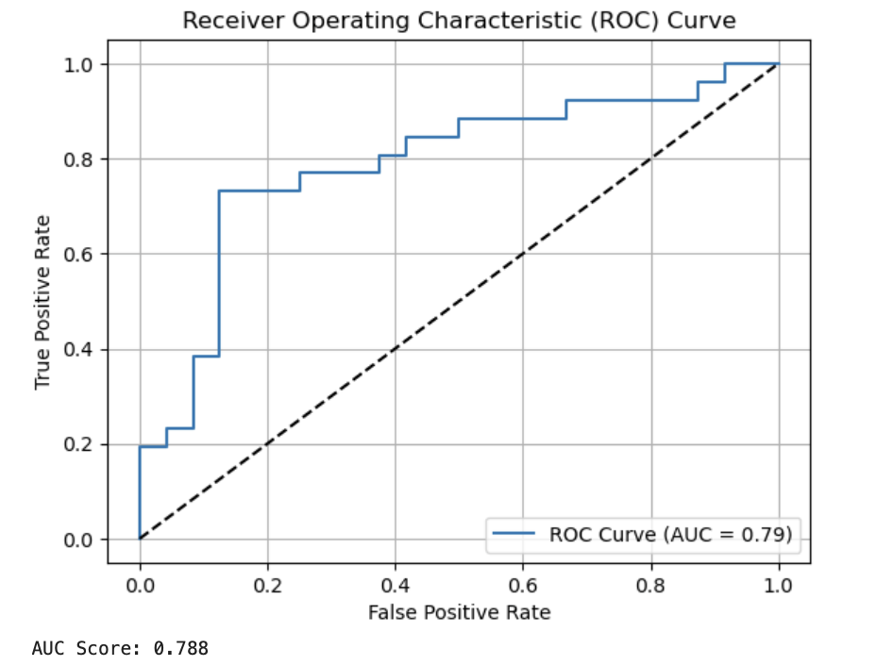
ROC (Receiver Operating Characteristics) Curve
Used to evaluate binary classifiers at different levels of cutoff (not just 50%)
X axis =False Positive Rate = FP / (FP + TN)
Y axis = True Positive Rate = TP / (TP / FN)
Area under curve (AUC) closer to 1 indicates better discrimination.
The diagonal corresponds to random guessing.

Slide 21
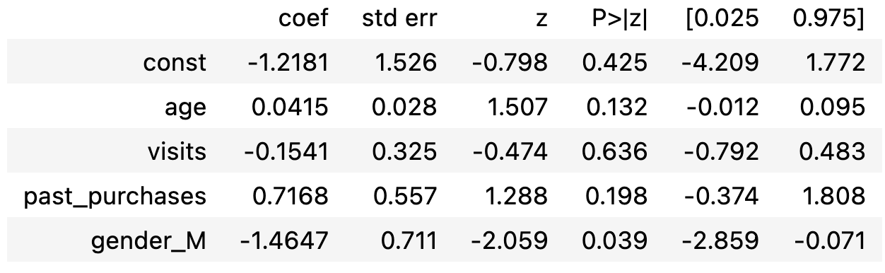
Hypothesis Testing / Statistical Significance
Z = (Estimated Coefficient - Hypothesized Value) / Standard Error
H0 = Bj = 0 by default, so default is just Estimated Coefficient / Standard Error
Find CV from Z table for a selected level of alpha
If abs(Z) > abs(CV), reject the null hypothesis
Or, if p < alpha, reject the null hypothesis

Slide 22
Comparing Models (same dataset)
Statistic | Better When
Pseudo R^2 | Higher
AIC | Lower
BIC | Lower
Accuracy | Higher
Precision | Higher
Recall | Higher
F1 | Higher

Slide 23
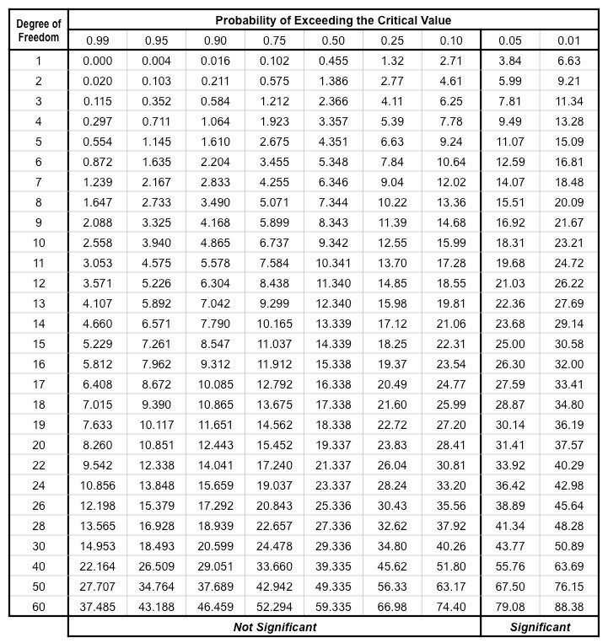
Comparing Nested Models - Likelihood Ratio Test
Full Model: The model with all final independent variables included
Reduced Model: A model with only some of the independent variables included in the full model and no independent variables that are not included in the full model
LLR Test Stat = -2 * (log-likelihood of reduced model - log-likelihood of full model)
CV = Chi-Square for degrees of freedom = number of variables dropped in reduced model
If Stat > CV, reject null hypothesis that additional variables do not add significant predictive power to the model
Or use calculated p-value vs alpha

Slide 24
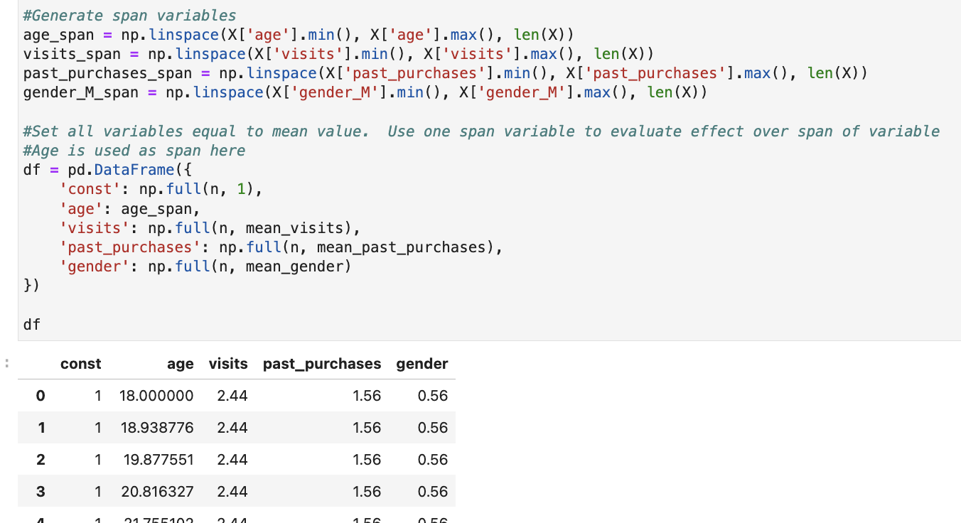
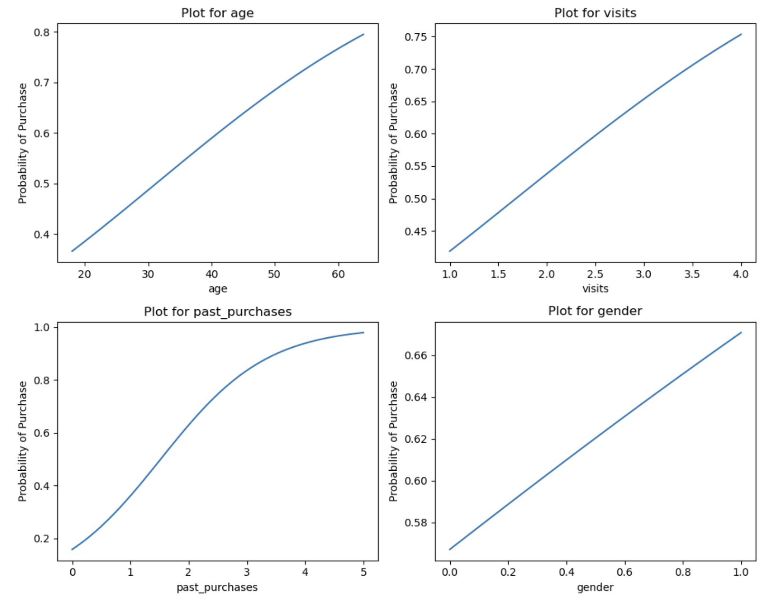
Simulation
Create a sequence of evenly spaced values across the observed range of the variables of interest (span variables)
Set each variable equal to its mean (or any other values you want to use), except the one you want to investigate
Calculate predictions and see how p(Y=1) changes as the other variable moves from lowest to highest values

Slide 25
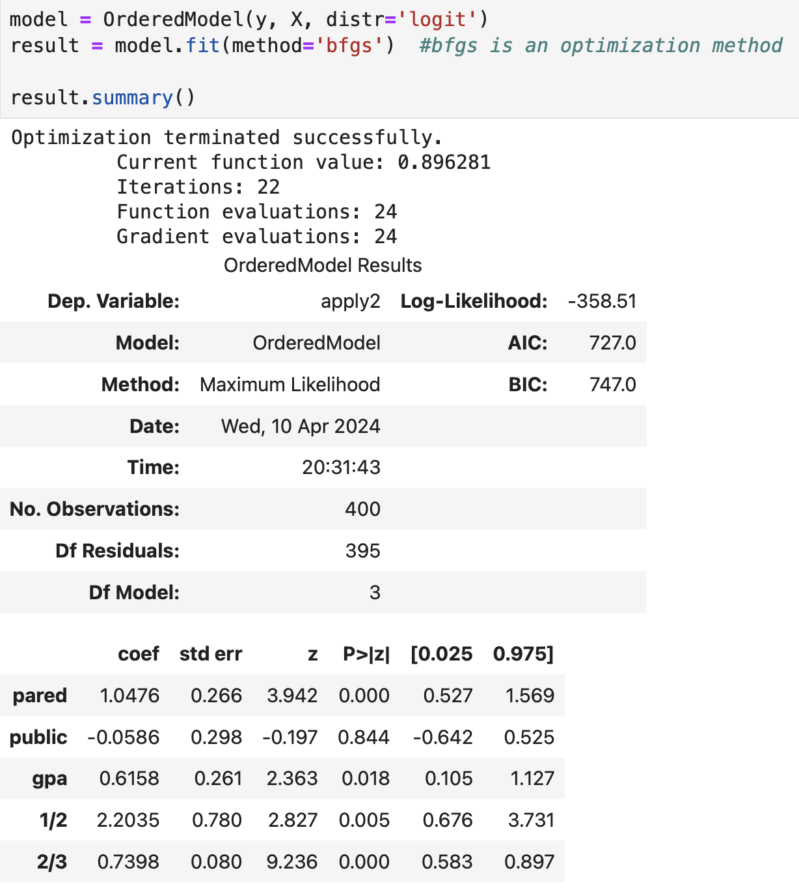
Ordered Logistic Regression
What if dependent variable is ordinal?
Example: 1 if totally dissatisfied, 2 if slightly dissatisfied, 3 if neither satisfied nor dissatisfied, 4 if slightly satisfied, 5 if highly satisfied.
OLS assumptions are violated (outcome (Y) is ordinal, not continuous with equal spacing)
Complications:
Proportional odds required - The effect of each predictor assumed to be the same across cumulative logits / thresholds
Slightly more complicated interpretation of coefficients
Coefficient Interpretation: A one-unit increase in X is associated with a B increase in the log odds of being in a higher category
Cutpoints have no direct interpretation, but are still important to the calculation

Slide 26
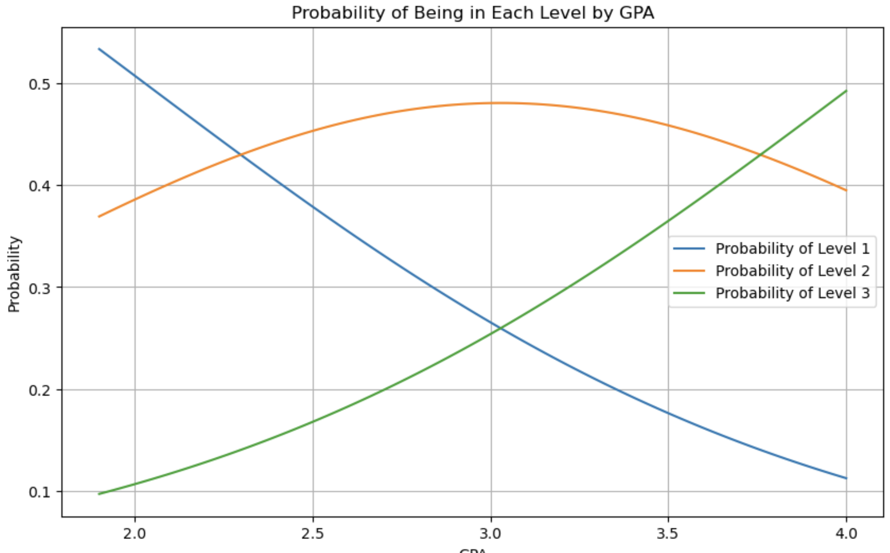
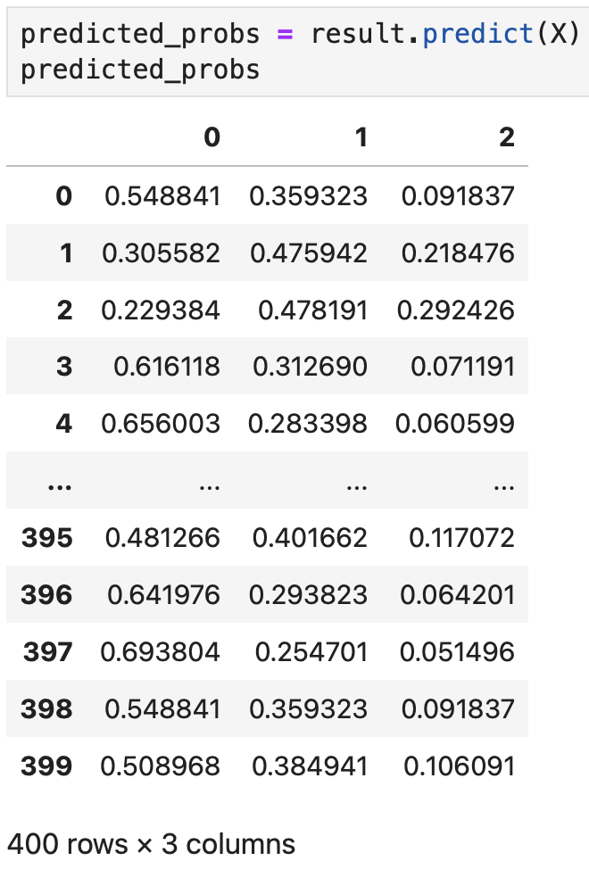
Ordered Logistic Regression - Predicted Probabilities

Slide 27
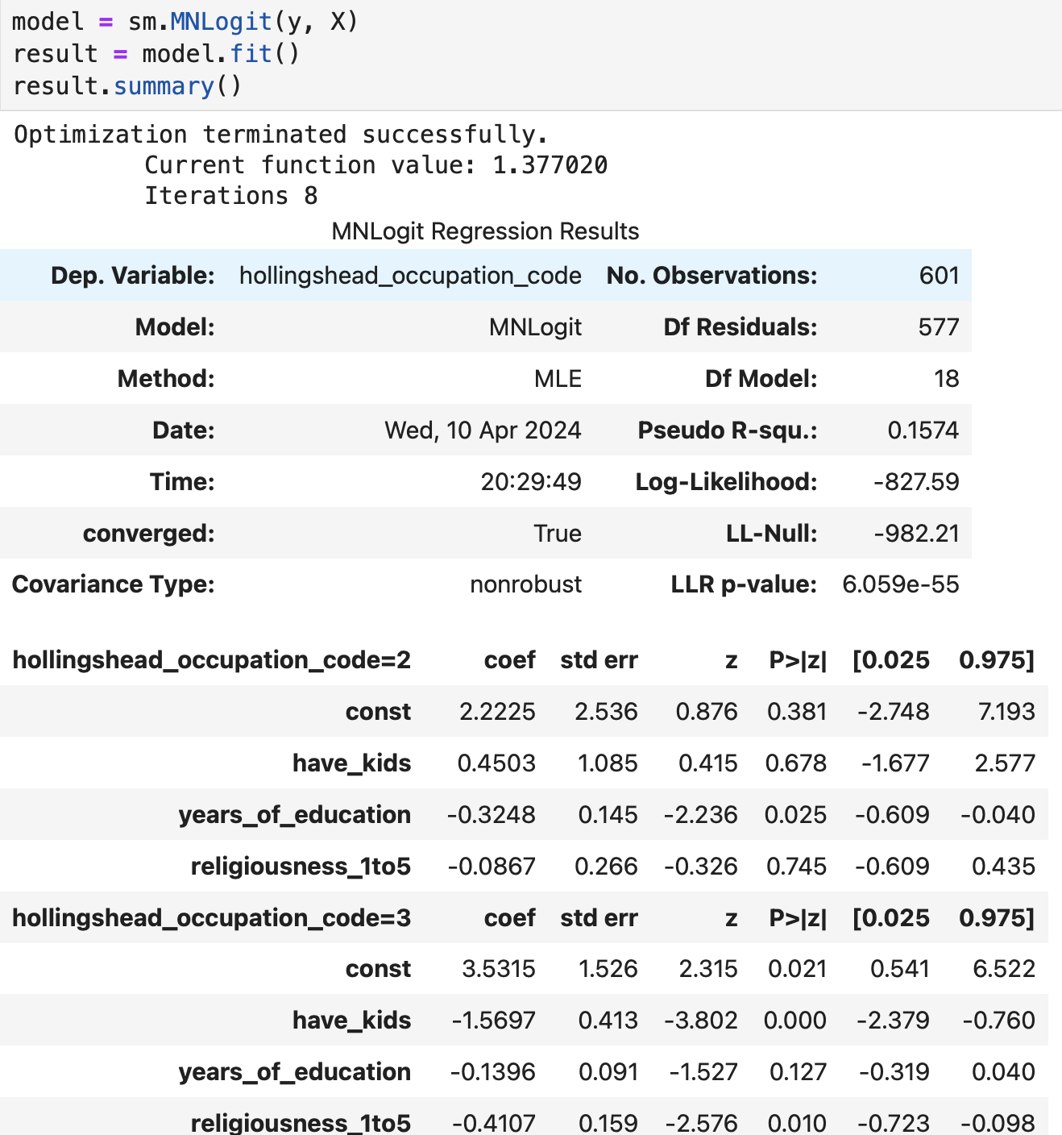
Multinomial Logistic Regression
What if dependent variable is nominal (categorical, labels, unordered)?
Example: Favorite streaming service, flavor of ice-cream, major, religion, etc.
Coefficients are made with respect to a reference category and tell the log odds of being in each category relative to the reference category for a one unit change in X

Slide 28
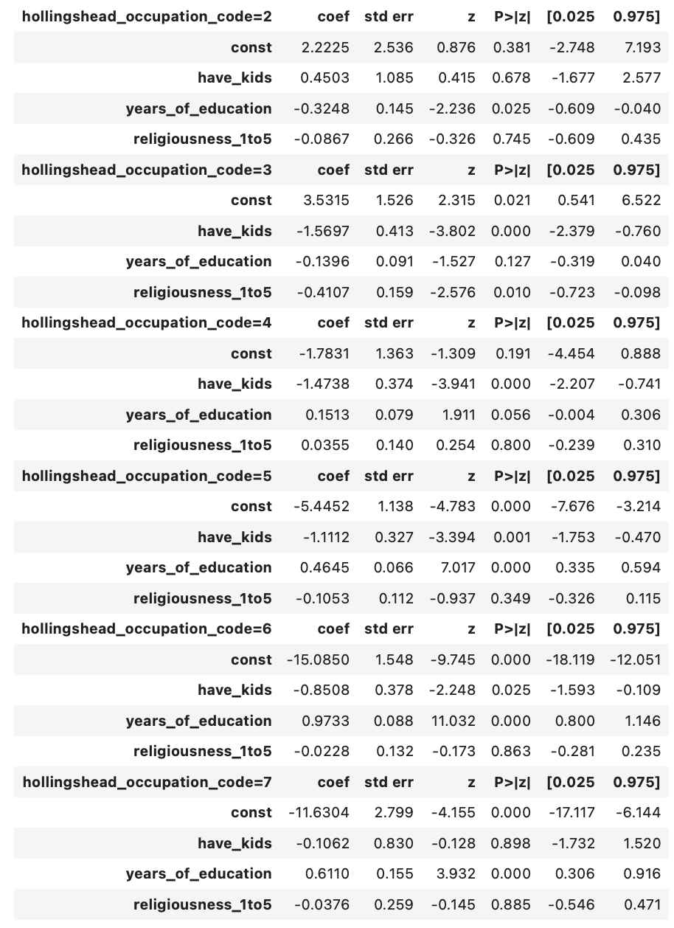
Multinomial Logistic Regression Interpretation
Coefficients are created for all but one of the values of Y
In the example, occupation code 1 is the omitted / reference category
A one-year increase in years of education increases the log odds of being in category 4 instead of the reference category (1) by 0.1513 and the odds by 16.34%, since ((e^0.1513) -1) = 0.1634

Slide 29
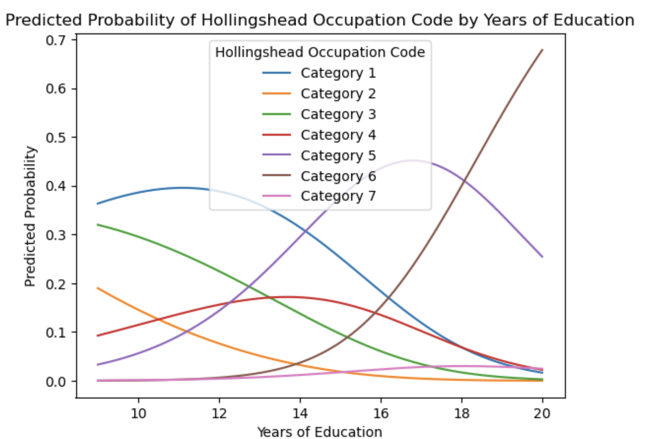
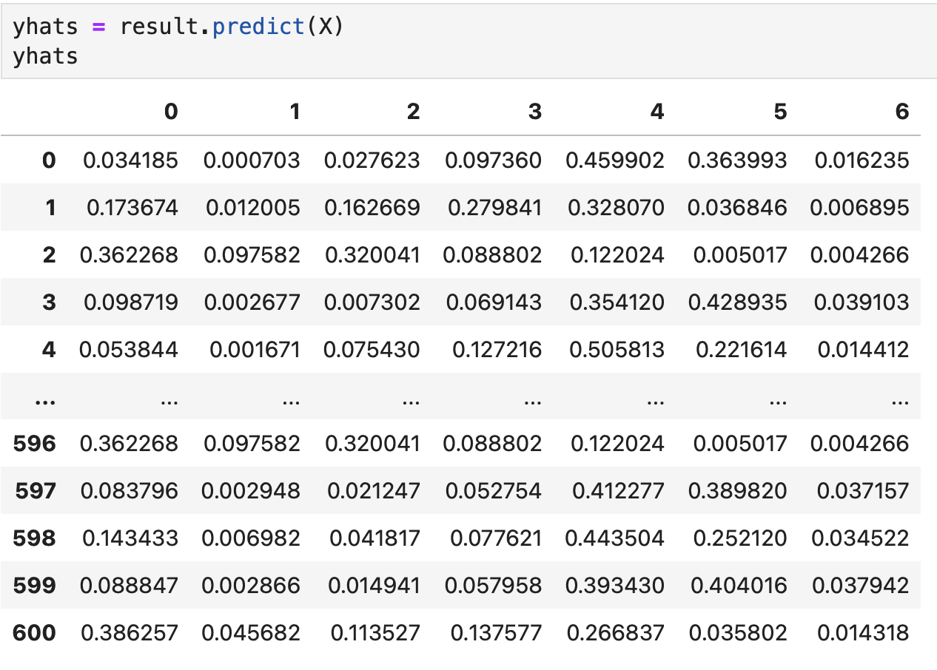
Multinomial Logistic Regression - Predicted Probabilities

Slide 30
Probit!
Probit is another model of binary choice
Logit uses logistic CDF, while Probit uses standard normal CDF
Logit is often considered easier to interpret, if you can believe that
Results are often very similar to logit

